Slide 1
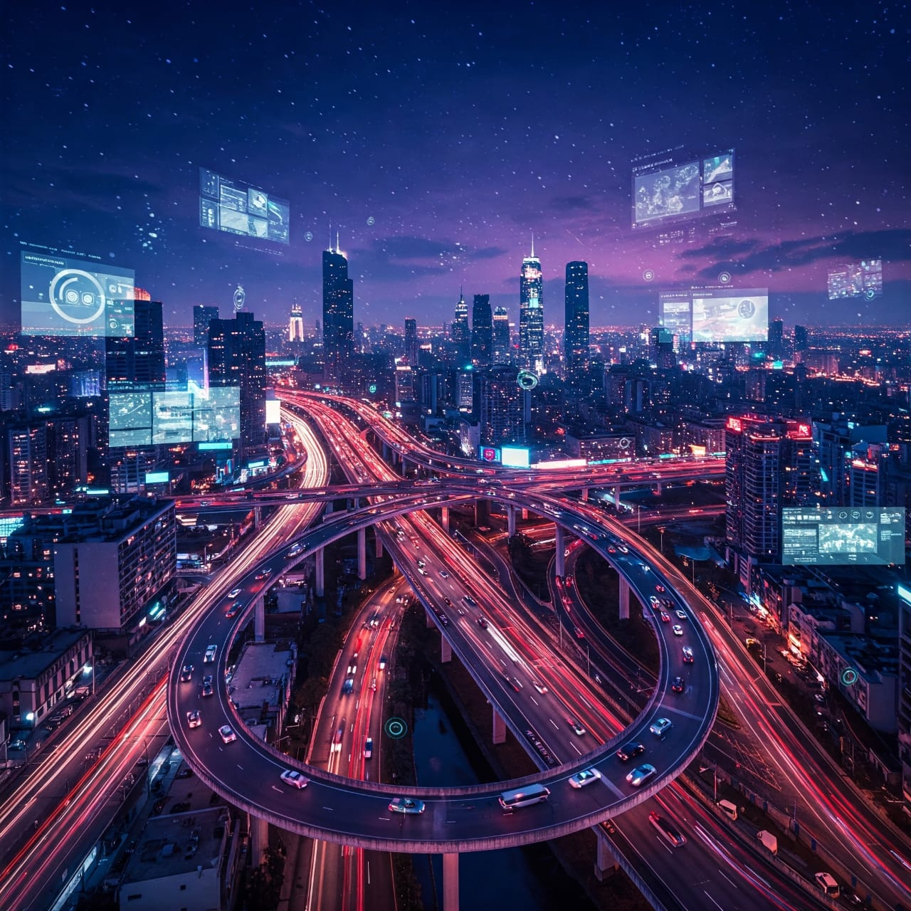
SMART TRAFFIC SYSTEM
PRESENTED BY
Priyanshu Sinha
Department of EEE, SILICON UNIVERSITY

Slide 2
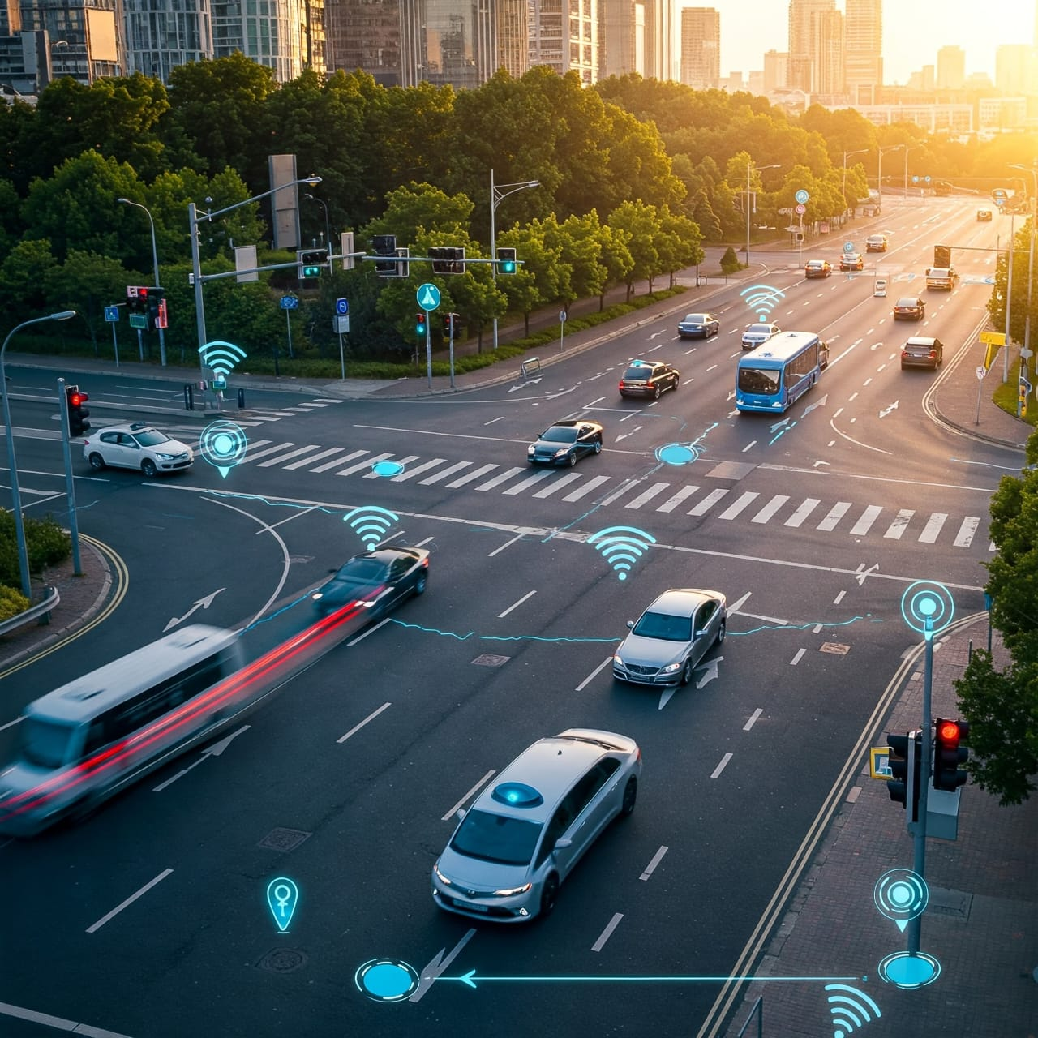
PROJECT OVERVIEW
Objective
To design & implement a Smart Traffic management System using IOT components to automate & optimise traffic control.
Key features:
RFID based vehicle identification
Ultrasonic sensor for vehicle detection
Vibration sensor for accident detection
Automated traffic lights
Real time control and alerts

Slide 3
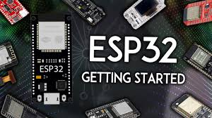
Components used
ESP32 Microcontroller: Core processing & Wi-fi connectivity.
RFID Module(MFRC522): Vehicle detection at traffic junction.
Traffic light LEDs & Relay Modules: Light control system
Power Supply & breadbroad: Circuit support & prototyping

Slide 4
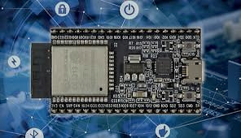
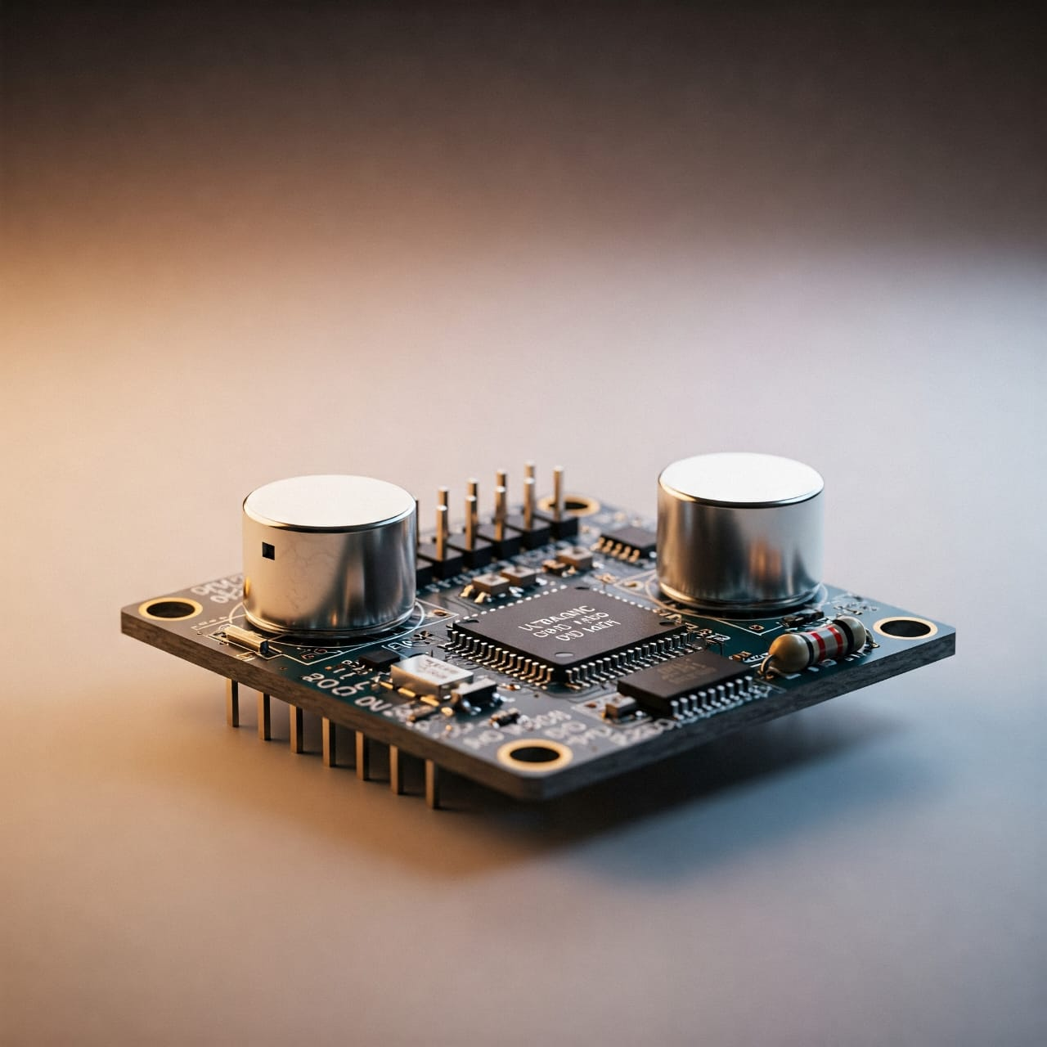
Working principle
RFID tags are detected at entry points to prioritize emergency or authorized vehicles.
Ultrasonic sensors detect vehicle density to dynamically change traffic light durations.
Vibration sensor identifies accidents & alerts control system.
ESP32 processes all inputs & controls lights via relays.
Data is processed & monitored using C++ & python code compiled using ARDUINO AI compiler.

Slide 5
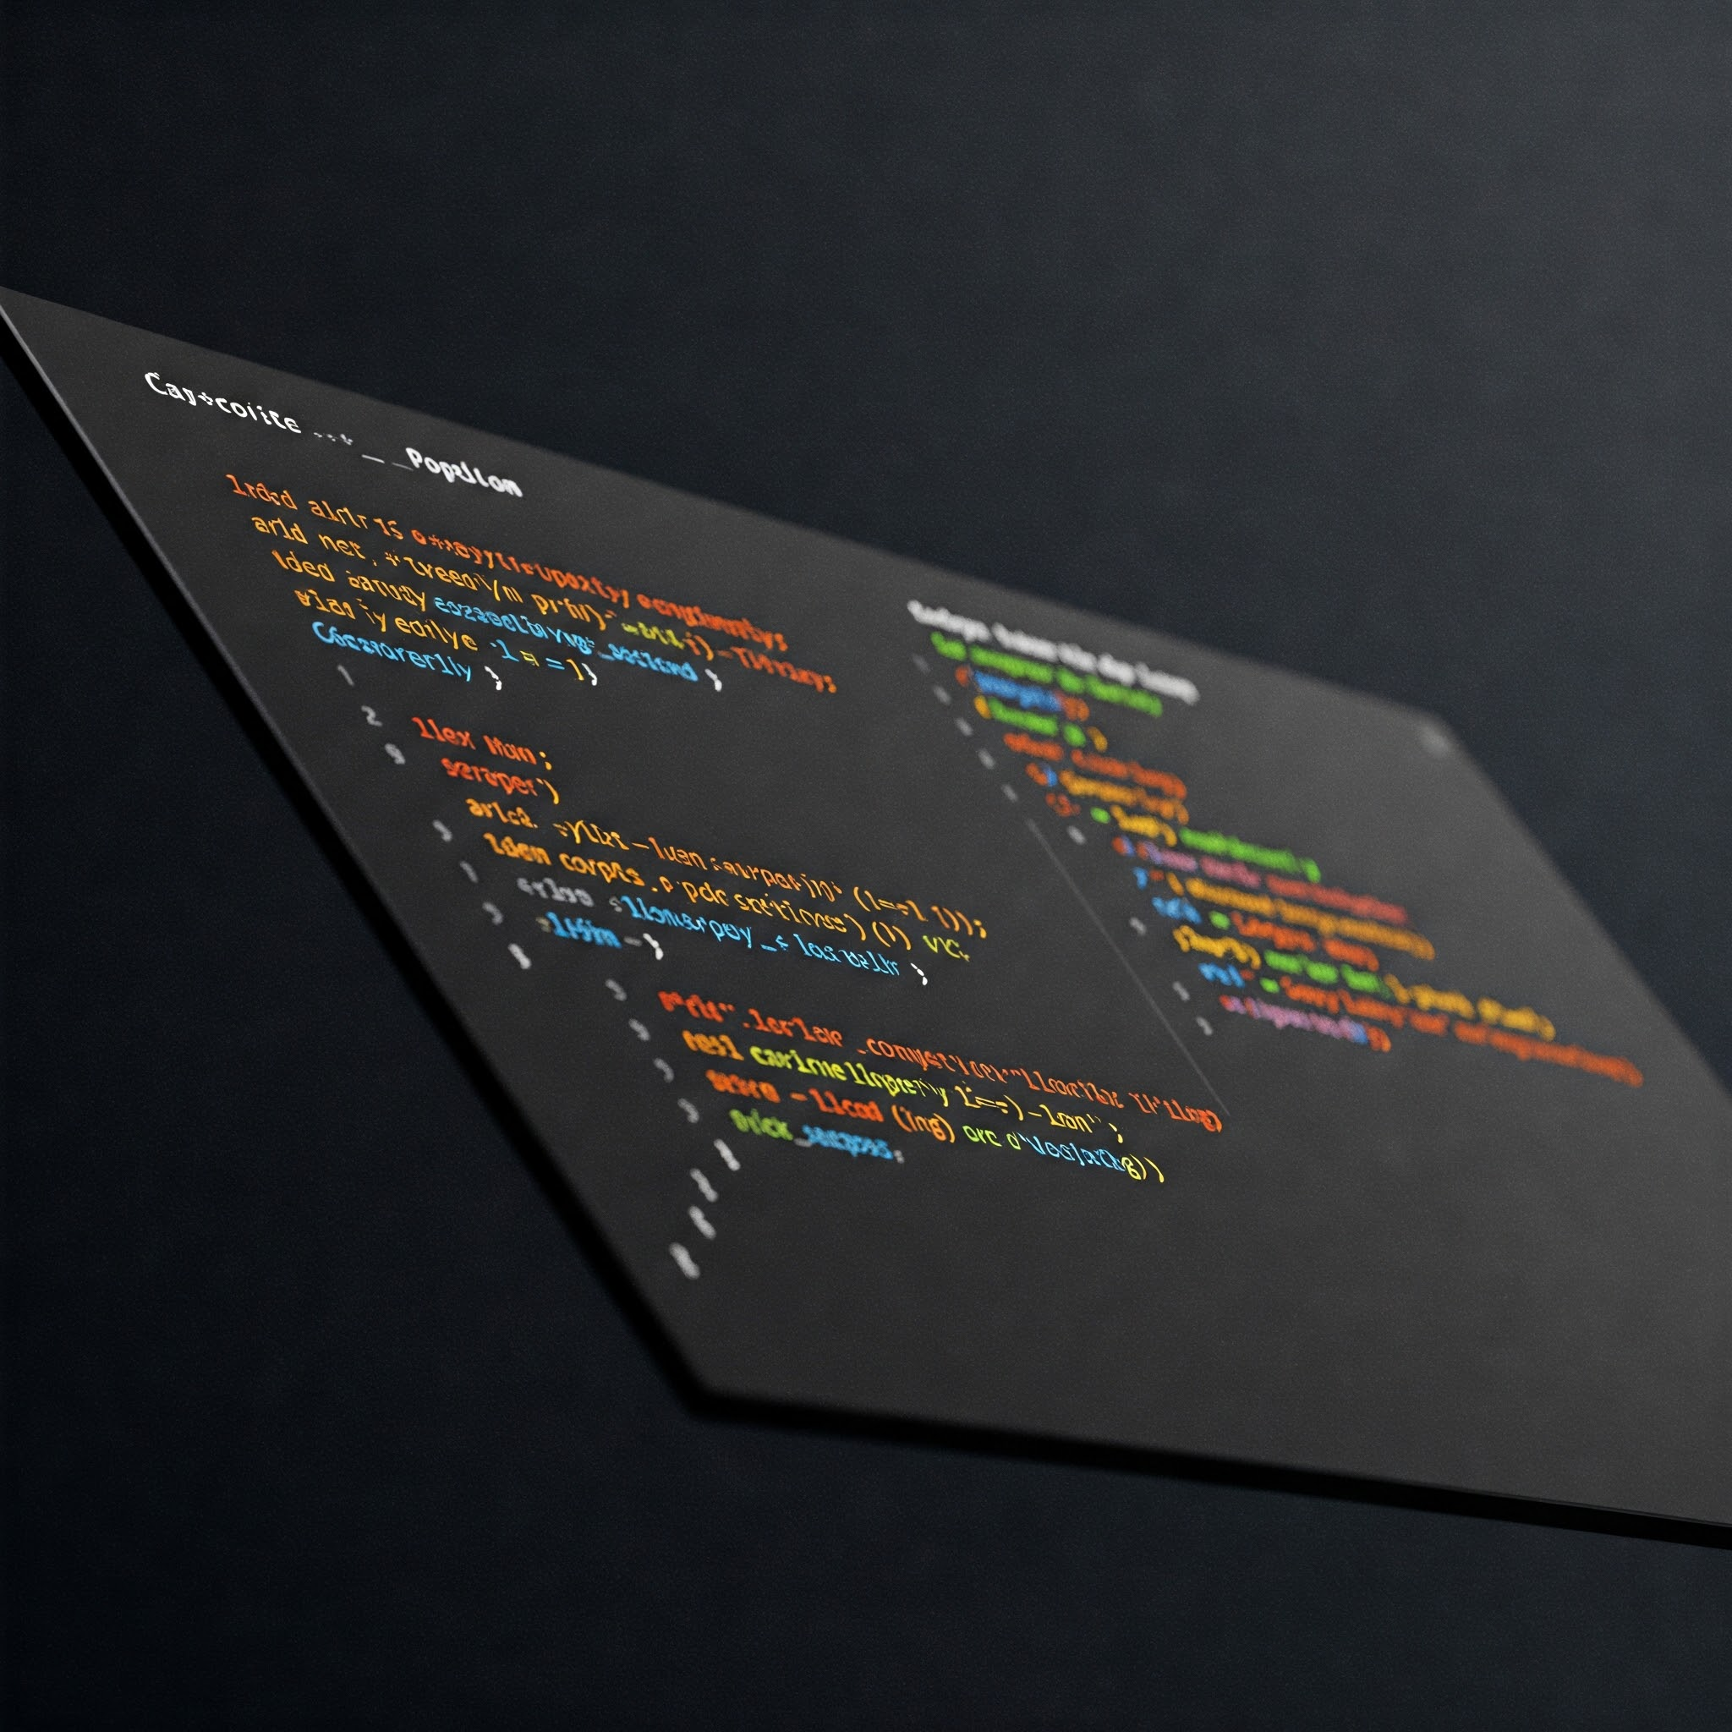
Programming details
Languages Used:
C++ for sensor interfacing and relay control
Platform: Arduino IDE
Features:
Modular code structure
Real time sensor polling
Dynamic LED control logic

Slide 6
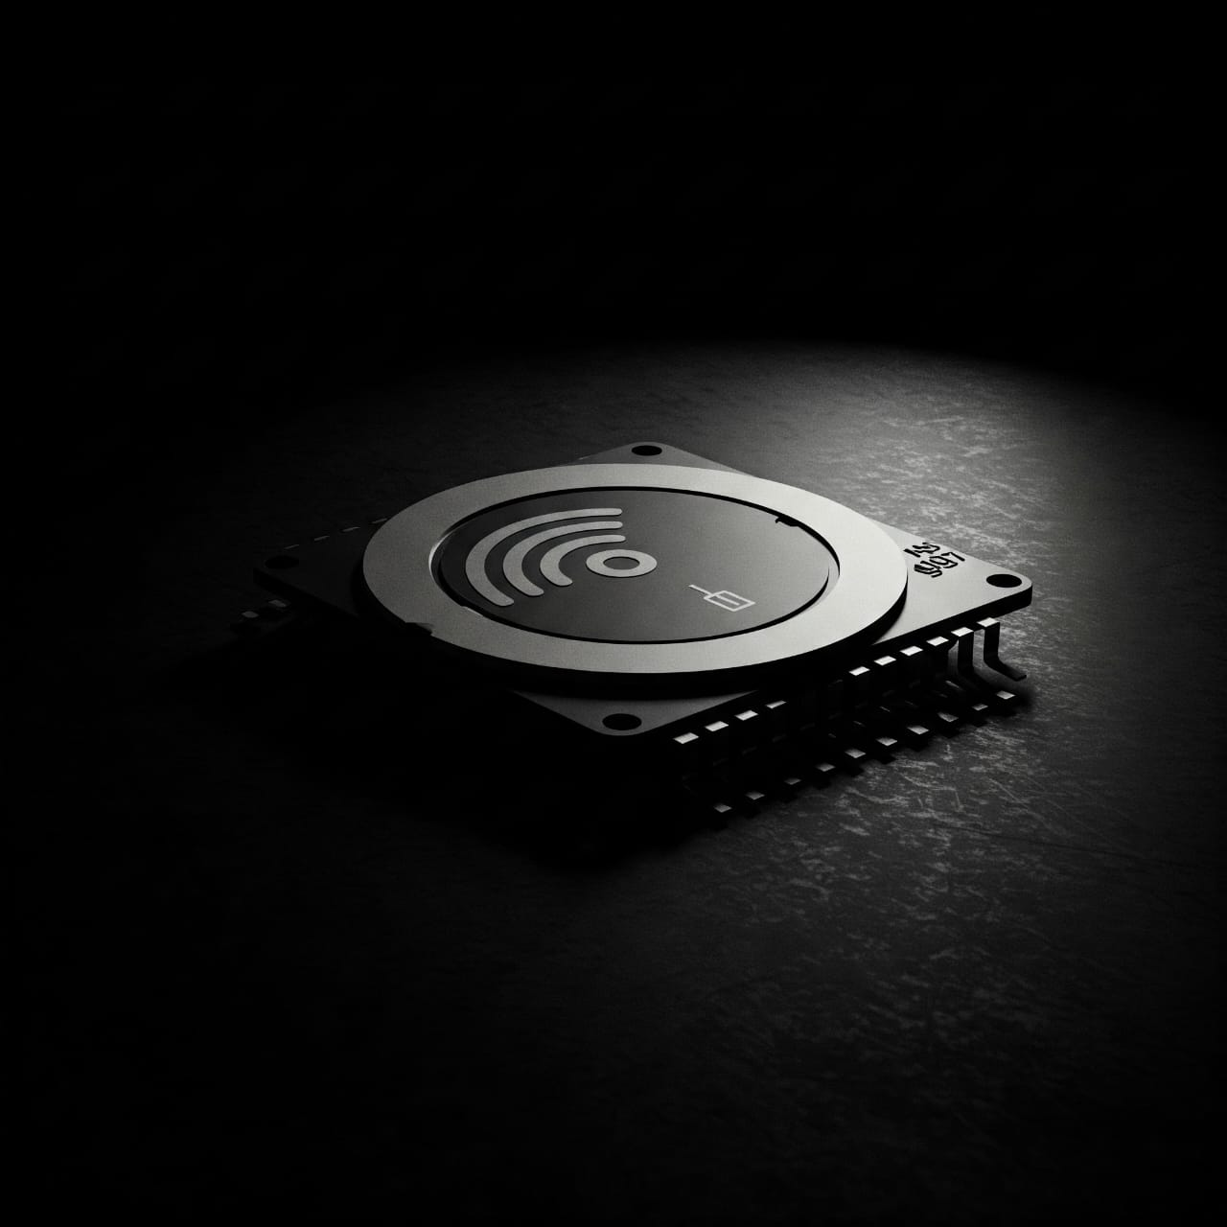
Results & Observations
Successfully detected vehicle presence using ultrasonic sensors
RFID based vehicle priority worked as expected
LEDs switched according to real-time traffic flow

Slide 7
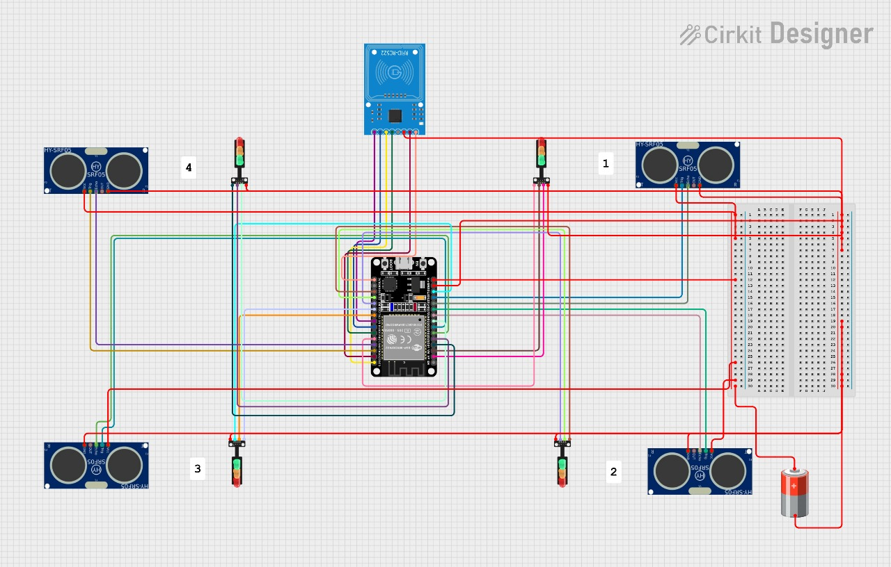
For Four Way system

Slide 8
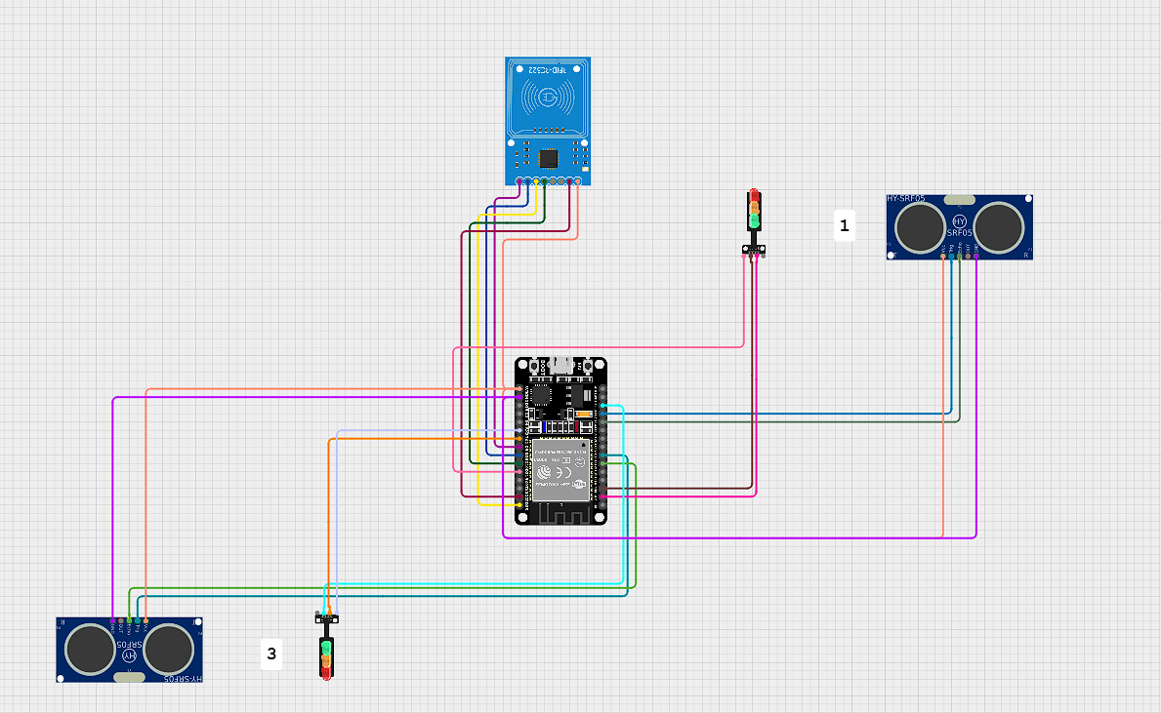
For Two Way system

Slide 9
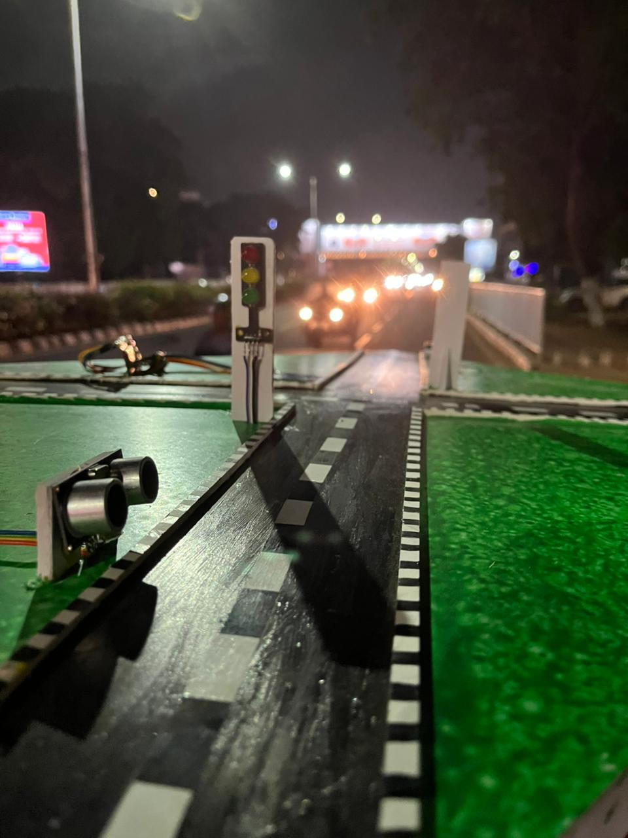
#include <SPI.h>
#include <MFRC522.h>
// RFID Pins
#define SS_PIN 5
#define RST_PIN 4
MFRC522 rfid(SS_PIN, RST_PIN);
// Traffic Light Pins
#define R1 25
#define Y1 26
#define G1 27
#define R2 14
#define Y2 12
#define G2 13
// Ultrasonic Sensor Pins
#define TRIG1 15
#define ECHO1 2
#define TRIG2 17
#define ECHO2 16
// Settings
const int vehicleThreshold = 10; // cm
int greenTime = 5000; // 5 seconds
int yellowTime = 3000; // 3 seconds
int allRedPause = 3000; // 3 seconds
void setup() {
Serial.begin(115200);
SPI.begin();
rfid.PCD_Init();
// Set pin modes
pinMode(TRIG1, OUTPUT); pinMode(ECHO1, INPUT);
pinMode(TRIG2, OUTPUT); pinMode(ECHO2, INPUT);
pinMode(R1, OUTPUT); pinMode(Y1, OUTPUT); pinMode(G1, OUTPUT);
pinMode(R2, OUTPUT); pinMode(Y2, OUTPUT); pinMode(G2, OUTPUT);
allRed();
Serial.println("🚦 Smart Traffic System Initialized");
}
void loop() {
// RFID Emergency Vehicle Detection
if (rfid.PICC_IsNewCardPresent() && rfid.PICC_ReadCardSerial()) {
if (isMasterCard()) {
Serial.println("🚨 Emergency Vehicle Detected → Road 1 Green");
greenLight(1, 20000);
allRed(); delay(2000);
} else {
String scannedUID = getUIDString();
Serial.print("Unknown RFID UID: ");
Serial.println(scannedUID);
}
rfid.PICC_HaltA();
return;
}
// Normal Traffic Cycle: Road 1
digitalWrite(R1, LOW); digitalWrite(G1, HIGH); digitalWrite(Y1, LOW);
digitalWrite(R2, HIGH); digitalWrite(G2, LOW); digitalWrite(Y2, LOW);
delay(greenTime);
digitalWrite(G1, LOW); digitalWrite(Y1, HIGH);
delay(yellowTime);
digitalWrite(Y1, LOW); digitalWrite(R1, HIGH);
delay(allRedPause);
// Road 2
digitalWrite(R2, LOW); digitalWrite(G2, HIGH); digitalWrite(Y2, LOW);
delay(greenTime);
digitalWrite(G2, LOW); digitalWrite(Y2, HIGH);
delay(yellowTime);
digitalWrite(Y2, LOW); digitalWrite(R2, HIGH);
delay(allRedPause);
// Check for vehicle presence
bool road1Busy = isVehicleConstantlyPresent(TRIG1, ECHO1);
bool road2Busy = isVehicleConstantlyPresent(TRIG2, ECHO2);
if (road1Busy) {
Serial.println("📈 Road 1 is busy → Extending Green");
greenLight(1, greenTime + 5000);
} else if (road2Busy) {
Serial.println("📈 Road 2 is busy → Extending Green");
greenLight(2, greenTime + 5000);
}
// Print distances
long distance1 = getDistance(TRIG1, ECHO1);
long distance2 = getDistance(TRIG2, ECHO2);
Serial.print("Distance on Road 1: ");
Serial.print((distance1 == -1) ? "Error" : String(distance1) + " cm");
Serial.print(" | Distance on Road 2: ");
Serial.println((distance2 == -1) ? "Error" : String(distance2) + " cm");
delay(1000);
}
// Get Distance from Ultrasonic Sensor
long getDistance(int trig, int echo) {
digitalWrite(trig, LOW);
delayMicroseconds(2);
digitalWrite(trig, HIGH);
delayMicroseconds(10);
digitalWrite(trig, LOW);
long duration = pulseIn(echo, HIGH, 30000); // timeout 30ms
if (duration == 0) return -1;
return duration * 0.0343 / 2;
}
// Check if vehicle consistently present
bool isVehicleConstantlyPresent(int trig, int echo) {
int count = 0;
for (int i = 0; i < 5; i++) {
long d = getDistance(trig, echo);
if (d > 0 && d < vehicleThreshold) count++;
delay(200);
}
return count >= 4; // majority detected
}
// Convert UID to String
String getUIDString() {
String content = "";
for (byte i = 0; i < rfid.uid.size; i++) {
if (rfid.uid.uidByte[i] < 0x10) content += "0";
content += String(rfid.uid.uidByte[i], HEX);
if (i < rfid.uid.size - 1) content += " ";
}
content.toUpperCase();
return content;
}
// Check if Scanned UID Matches Emergency UID
bool isMasterCard() {
String uidStr = getUIDString();
Serial.print("Scanned UID: ");
Serial.println(uidStr);
return (uidStr == "83 22 29 3"); // Replace with your actual emergency UID
}
// Give green light to specified road
void greenLight(int road, int duration) {
if (road == 1) {
digitalWrite(G2, LOW); digitalWrite(Y2, HIGH);
delay(2000);
digitalWrite(Y2, LOW); digitalWrite(R2, HIGH);
digitalWrite(R1, LOW); digitalWrite(G1, HIGH);
} else {
digitalWrite(G1, LOW); digitalWrite(Y1, HIGH);
delay(2000);
digitalWrite(Y1, LOW); digitalWrite(R1, HIGH);
digitalWrite(R2, LOW); digitalWrite(G2, HIGH);
}
delay(duration);
digitalWrite(G1, LOW); digitalWrite(G2, LOW);
}
// Turn all lights to red
void allRed() {
digitalWrite(R1, HIGH); digitalWrite(Y1, LOW); digitalWrite(G1, LOW);
digitalWrite(R2, HIGH); digitalWrite(Y2, LOW); digitalWrite(G2, LOW);
}

Slide 10
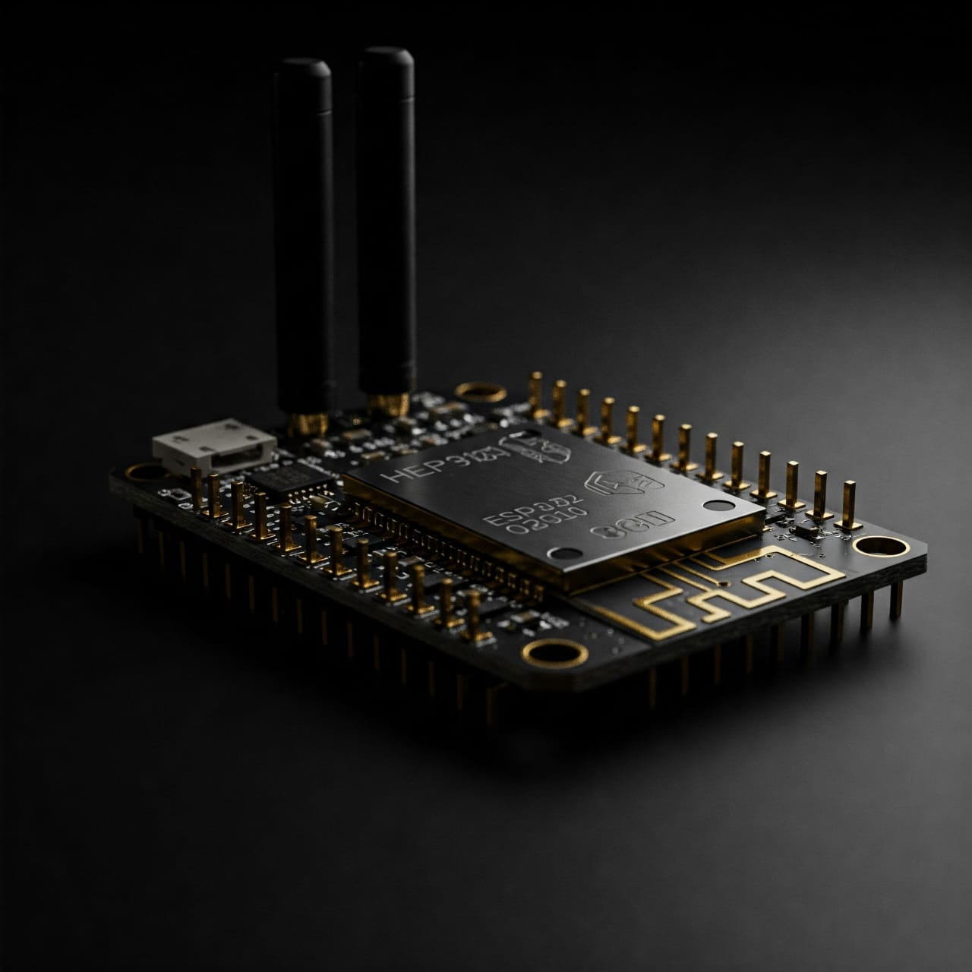
Applications
Smart city traffic management
Emergency vehicle prioritization
Accident detection & reporting
Scalable for multiple junctions

Slide 11
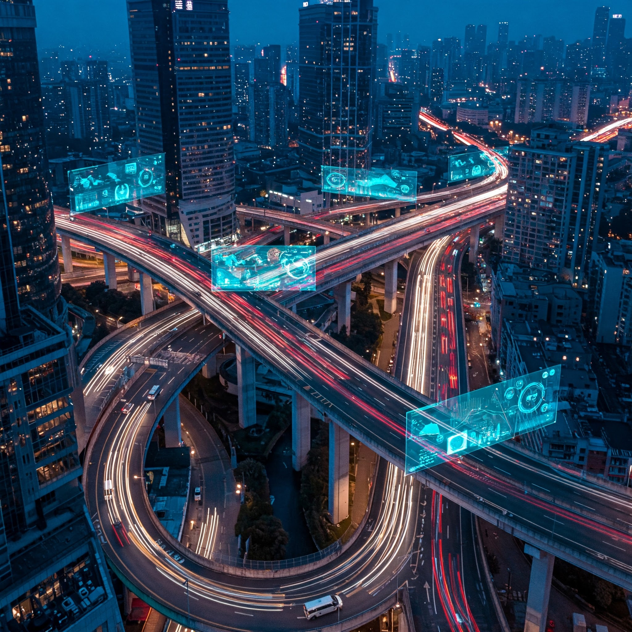
Future enhancements
Integration with cloud for remote monitoring
GPS module for vehicle plate detection
Mobile app integration
Camera module for license plate detection

Slide 12
CONCLUSION
Implemented a functional smart traffic system using IOT & ESP32
Achieved real time traffic sensing & control
Project combines embedded systems with AI compiled logic

